Slide 1
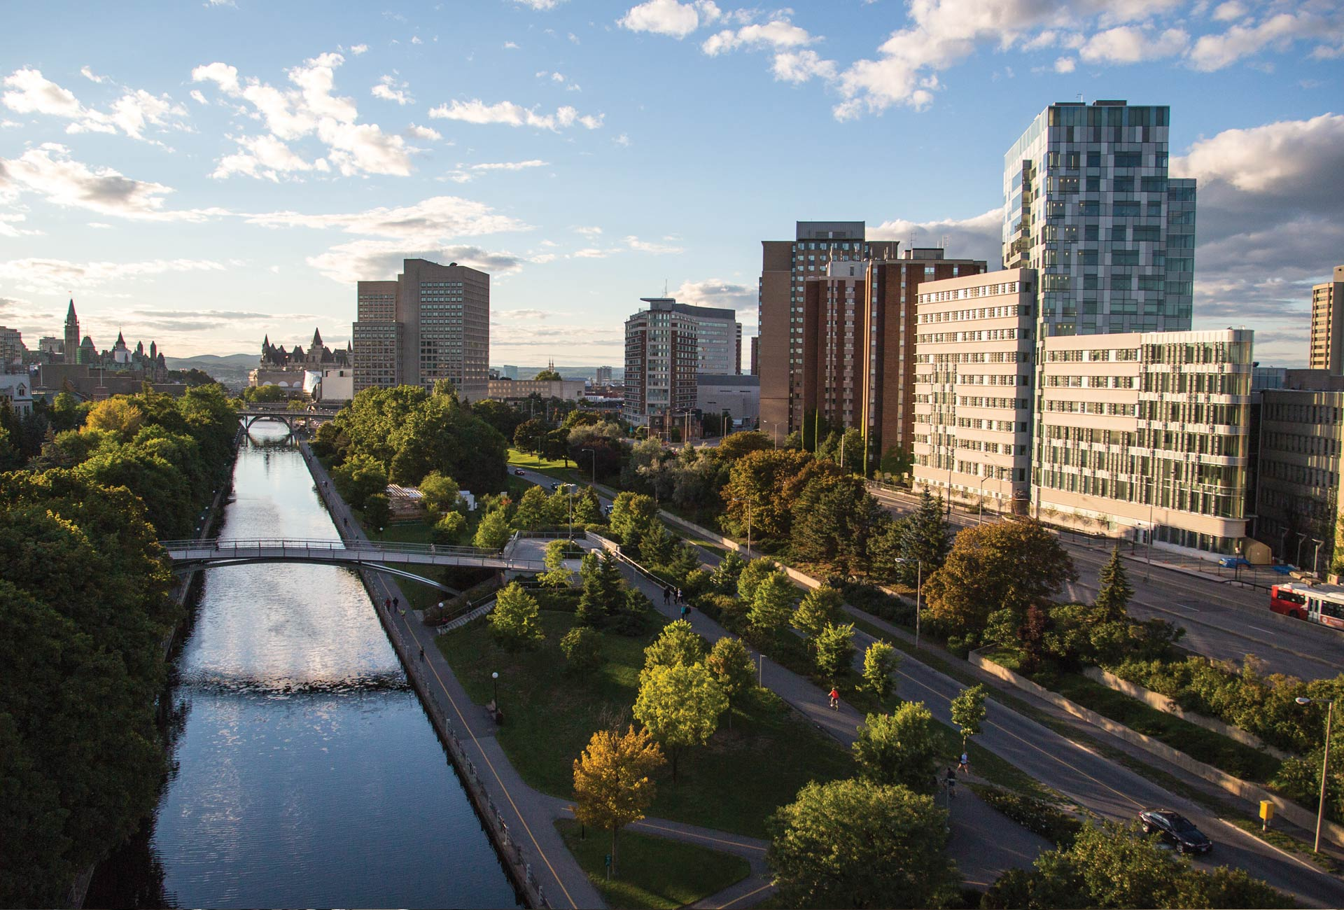
Portfolio Management Approach-Research infrastructure Projects
CARA national- Toronto 2015
uOttawa.ca

Slide 2
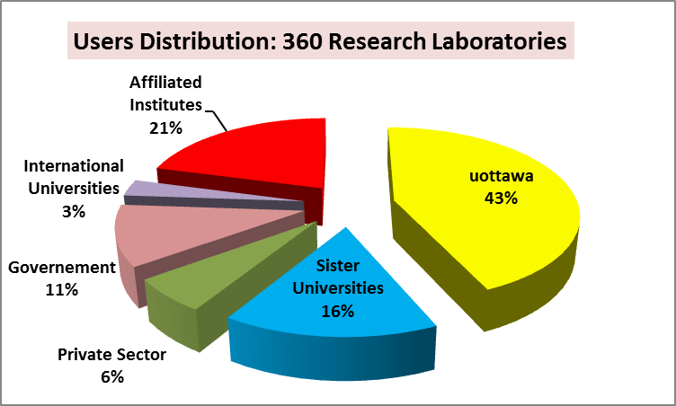
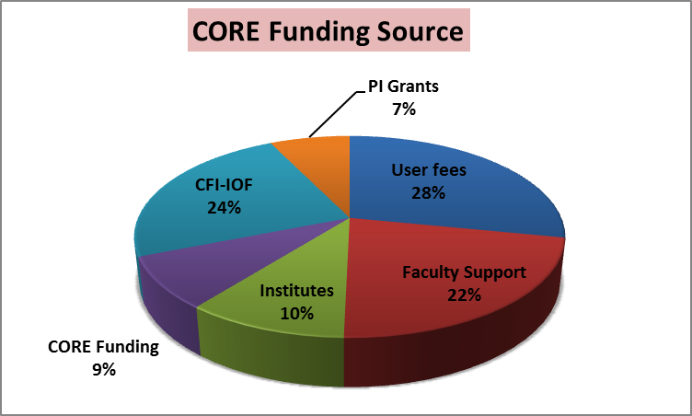
Core Facilities Program
2
Core Facilities provide services, analyses, instrument and technology access, or expertise needed and utilized by many investigators to conduct their research, but which are generally too expensive, complex or specialized for investigators to cost-effectively provide and sustain themselves.
By fostering a shared and common management of similar or complementary research facilities, Core Facilities offer the potential to realize significant benefits through, amongst others:
- Broad access to state-of-the art services, facilities and technology,
Financial savings resulting from economies of scale and the development and consolidation of in-house maintenance capabilities,
Availability of skilled operators to ensure skilled use of equipment, enhance data quality and assure safe operations,
Increased reliability of equipment,
- Reduced duplication of effort
Core Facilities are broadly available to all University of Ottawa researchers on a service basis with no requirement for scientific collaboration or co-authorship other than normal acknowledgement based on contributions in accordance with normal scientific practice
24 Core Facilities
Launched in 2010.
25% of our research groups use more than 2 Core Facilities.
User Average/Core = 27 Research Groups

Slide 3
Centralized-Strategic approach to fill the Infrastructure Gap and to optimize its sustainability over its useful lifetime...
The “Research Infrastructure Inventory RII” is intended to:
Identify infrastructure needs required to capitalize on major research opportunities and to conduct a gap analysis to meet our short-term and long-term infrastructure needs in order to support research at uOttawa.
Insure future competitiveness within areas of current strength and areas of emerging importance. Determine how should future infrastructure needs be identified, evaluated, prioritized, and financed.
Provide Department/Faculty with an up-to-date and readily accessible record of equipment within their department/Faculty.
Assists departments, faculties and researchers in locating specific types of equipment on campus.
Acquire replacement funding for capital equipment from the Federal/Provincial granting bodies.
Help sustaining the aggregate body of assets through planned maintenance, repair, and replacement.
Exercise de facto control and to demonstrate to granting bodies that uOttawa is holding a majority interest in the funded research infrastructure over its useful lifetime.

Slide 4
Centralized proposal development and oversight using a portfolio management approach
Centralized proposal development and oversight using a portfolio management approach which enables portfolio considerations and optimizes decision making.
Strategic Development Initiatives team: Alignment of initiatives with Strategic Research Plan.
Strong planning process to help ensure success and smooth implementation. Portfolio considerations front of mind
Portfolio considerations allow for identification of synergies, collaborations and interdependencies, and submission of best portfolio of investments for the university.
One RFP / Multiple infrastructure needs: Economy of scale and Resource optimization.
Amendment requests that benefit the portfolio of projects.

